Slide 1

Customer churn Prediction in a bank
Ingrid mongori yondo
Daft nov21
February 11, 2022

Slide 2

ABOUT THE PROJECT
Domain: Finance
Data Source: Data about bank churn, 2019, Kaggle
Business Case: Prediction of customer churn in a bank.
Goal: Help the management team to predict whether or not the customer left the bank.

Slide 3
PLAN
DATA COLLECTION
EDA
DATA CLEANING
RESULTS
MODELS
Shape
Supervised ML
Unsupervised ML
Silhouette score
Accuracy score
Insights
Kaggle
Encoding
Undersampling
Remove Outliers
Imbalance
Target
EVALUATION
DATA MAP
Description of the variables
Confusion matrix

Slide 4
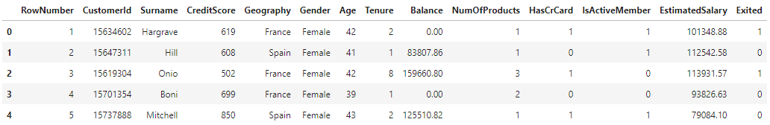
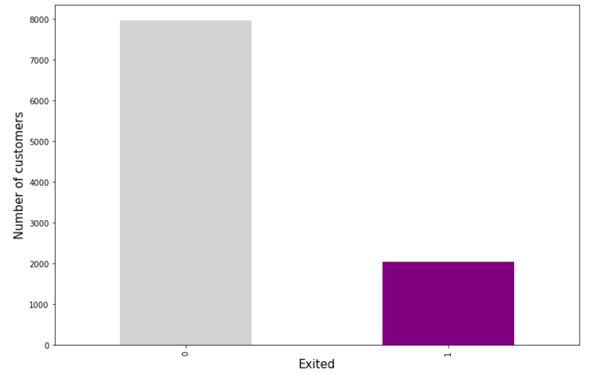
EDA
Shape: 10000 rows and 14 columns
Target: Exited — whether or not the customer left the bank. This is what we have to predict. (0=No,1=Yes)
Jupyter Notebook

Slide 5
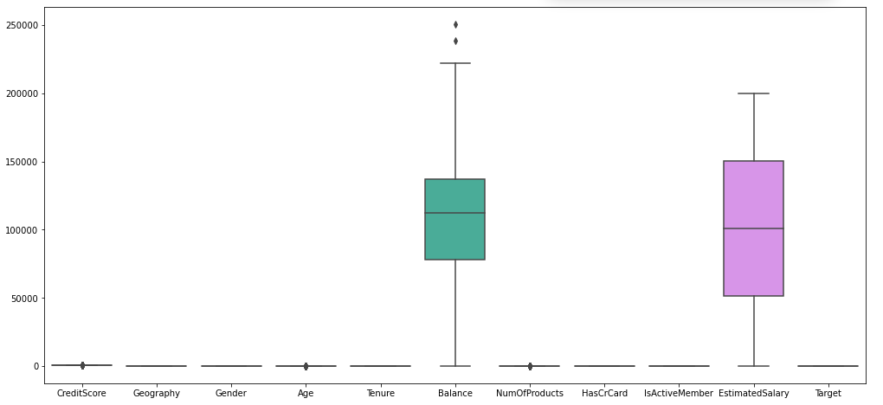
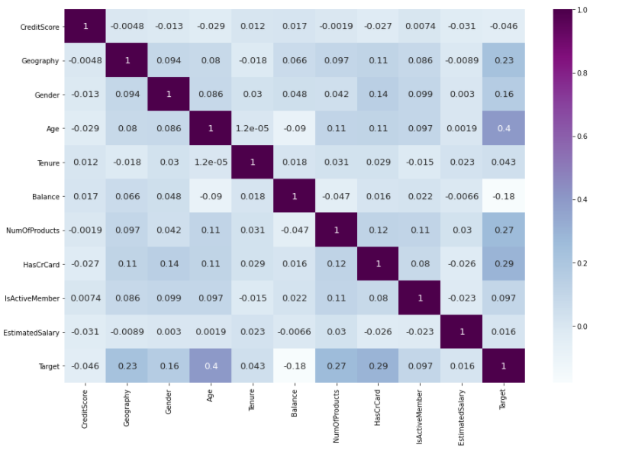
DATA CLEANING AND PREPROCESSING
Outliers - Boxplots
We don’t have any missing values or duplicates.
3 columns dropped: ‘RowNumber’, ‘CustomerId’ and ‘Surname’.
Encoding: Label encoder method for 2 columns ‘Geography’ and ‘Gender’.
Undersampling method (imblearn) → new shape: 4074 rows and 11 columns.
Remove 2 outliers → new shape: 4072 rows and 11 columns.
Correlation matrix - Heatmap

Slide 6
DATA CLEANING AND PREPROCESSING
Features Selection
Methods | Features
SFM | 4 : ['CreditScore', 'Age', 'Balance', 'EstimatedSalary']
RFE | 5 : ['CreditScore', 'Age’, ‘Tenure’, 'Balance', 'EstimatedSalary']
RFECV | All features
We test on 20% of the dataset.
GridSearch is too long.
3 categorical models: SVC, ExtraTreesClassifier and RandomForestClassifier.
Hyperparameters tuning: RandomizedSearchCV
Methods | Best parameters and score
SVC | {'gamma': 'scale', 'C': 45} - 0.8008
ExtraTreesClassifier | {'n_estimators': 285, 'max_depth': 15} - 0.8288
RandomForestClassifier | {'n_estimators': 355} - 0.8315

Slide 7

MODELS
We had to scale our data for all the models used in Machine Learning!!
Supervised machine learning
Unsupervised machine learning
Features Selection
Hyperparameters tuning
3 models: SVC, Extra Trees Classifier and Random Forest Classifier
KMEANS (+Elbow Method for selection of optimal number of clusters)
DBSCAN

Slide 8
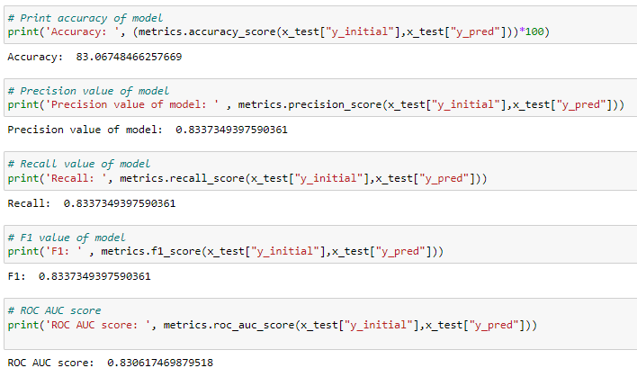
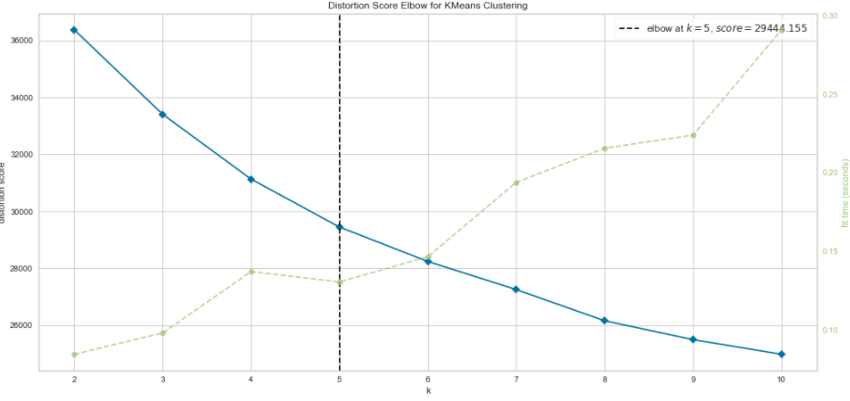
EVALUATION
Supervised ML
Random Forest Classifier is the best model.
Metrics
Unsupervised ML: poor results.
Elbow Method: k = 5
 | Silhouette score
KMEANS | 0,1987
DBSCAN | 0,2341

Slide 9
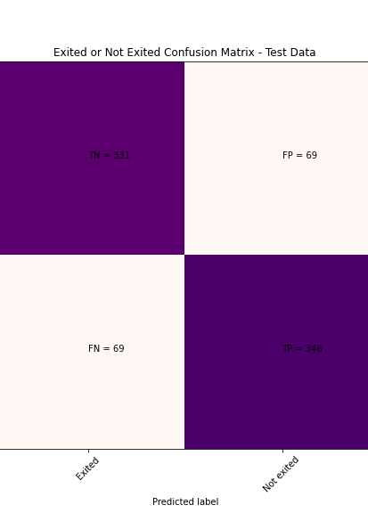
RESULTS
Our algorithm successfully predicts customer churn 83.19% of the time - churn rate: 20,4%.
Most important features: Age and Estimated Salary.

Slide 10

QUESTIONS

